Slide 1


Global Temperature Prediction
Team 5: Xiaochun (Beca) Wang, Jianghong (Nimo) Man, Ruobing Xue, Zimeng (Teresa) Wang
June 1, 2021
Notes:
Hello everyone, we are team 5. Today, we will introduce how to predict future global temperature using the time series models.

Slide 2




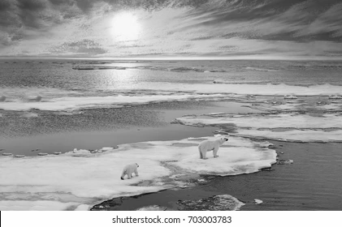
Our Team
research proposal
Nimo Man
BSBA Finance, Management of Information System @ Boston University
Business Problem, Introduction, Data Overview
Teresa Wang
BBA Finance, Psychology, Economics (minor) @ Emory University
Linear Regression, TSLM, Future Work & Conclusion
Ruobing Xue
Economics @CUFE
International Corporate Finance & Banking @ University of Glasgow
Senior Risk Manager @CreditEase
ETS, ARIMA Models
Beca Wang
BBA Management Information Systems, Psych, @ UT Austin
ARIMA Models, Model Evaluation and Selection
Notes:
And here is our team. In the following presentation, we also present what we did.

Slide 3

Introduction
Introduction | Data | Results & Analysis | Model Selection | Conclusion
Notes:
First, let me introduce the business problem and our workflow.

Slide 4





Change in Global Temperature
In a broader context, temperature affects many environmental factors in complex ways:
Detect any anomaly using the positive feedback between ambient temperature and the global carbon cycle
Control the rate of soil respiration and soil degradation using the correlation between global temperature and soil temperature
Use the predicted data in other eco-environmental models such as crop growth simulation, agro-ecological zoning, and food security assessment
Introduction | Data | Results & Analysis | Model Selection | Conclusion
Notes:
The temperature at the Earth’s surface is one of the most important environmental factors. For this project, we aim to predict the monthly global earth surface temperature in the following 12 months. Using the predicted data, we could make dependable forecasts underlie the foundation of sound environmental policies. For instance, the business use cases can be detecting anomalies of global carbon cycle, controlling the rate of soil respiration, and improving other eco-environmental models.

Slide 5
Our Specific Approaches
Model Selection
Prediction & Result
1
3
Make a 1-year prediction of the monthly global earth surface temperature
* Linear Model
* ETS Model
* ARIMA
EDA
Model Evaluation
2
Evaluate the accuracy of the results obtained.
4
* Overall temperature trend
* ACF + PACF
* Spectral Analysis
Introduction | Data | Results & Analysis | Model Selection | Conclusion
Notes:
Here are our basic approaches: First, we explored the given dataset and extracted the useful information. By the initial plots, we found our data are pretty neat. Then, we used several time-series models which comprises a deterministic trend plus random residuals. We applied three models: the linear model, ETS model, and the ARIMA process. After comparing their outcomes, we used the evaluation metrics, RMSE and AICc score, and finalize the one we would like to apply based on those metrics.

Slide 6

Data
Introduction | Data | Results & Analysis | Model Selection | Conclusion
Notes:
Next, let me go through our process in detail. First, our data.

Slide 7

Data Overview: Collected by Berkeley Earth
Contains monthly average temperature for land and ocean from 1750 to 2010
GlobalTemperatures.csv
3192 observations and 9 columns
Data Size
Utilized column:
LandAverageTemperature
Global average land temperature in celsius
Drop the missing values
Drop the missing values mostly from the beginning few years
Introduction | Data | Results & Analysis | Model Selection | Conclusion
Notes:
In terms of the collection process, we have the data repackaged by the Berkeley Earth. We only select one column as the major target input for this project, which is the global average land temperature in celsius. After dropping the missing values, we used the different period of data when applying different validation methods, which will be explained in detail in the following part.

Slide 8
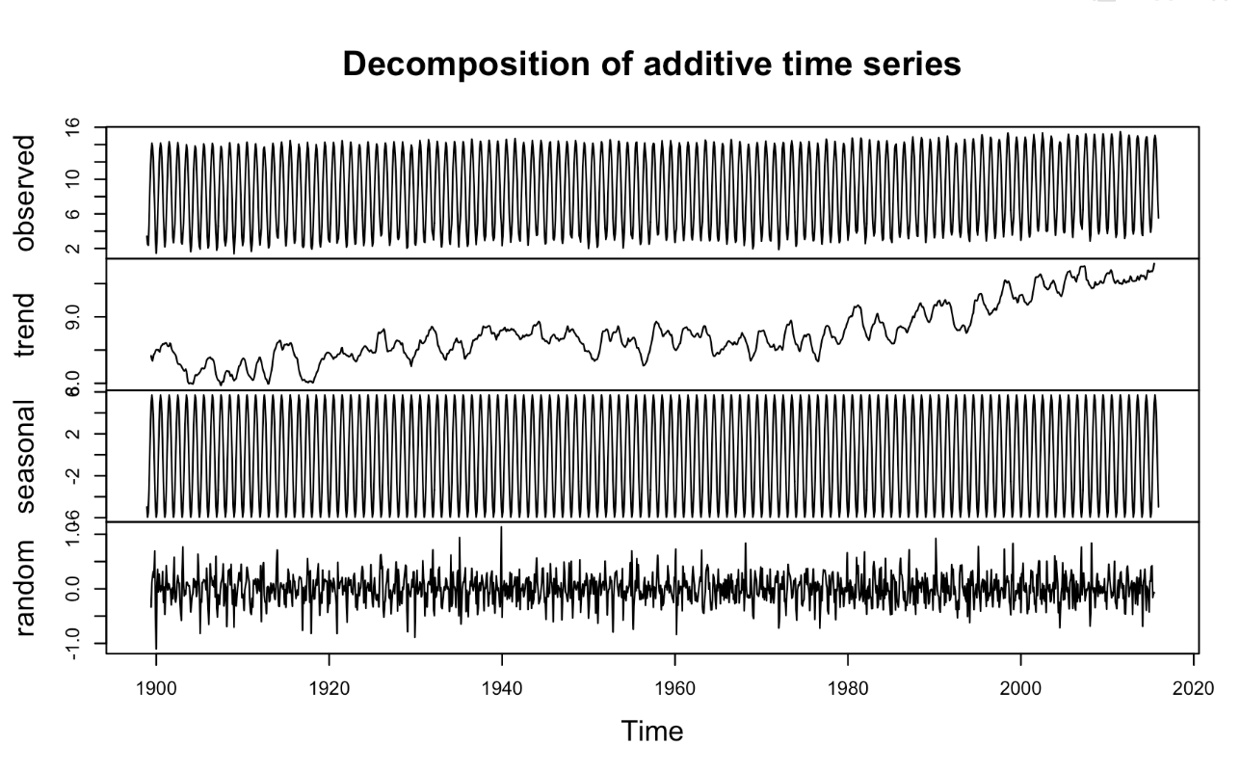
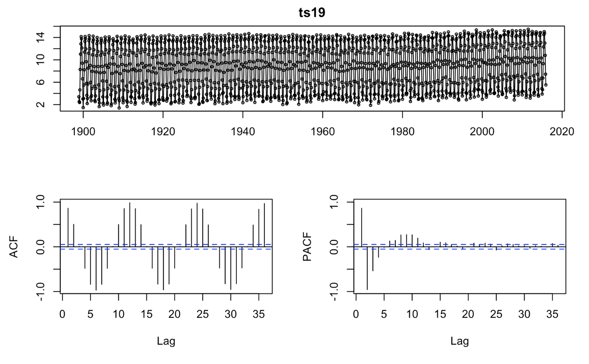
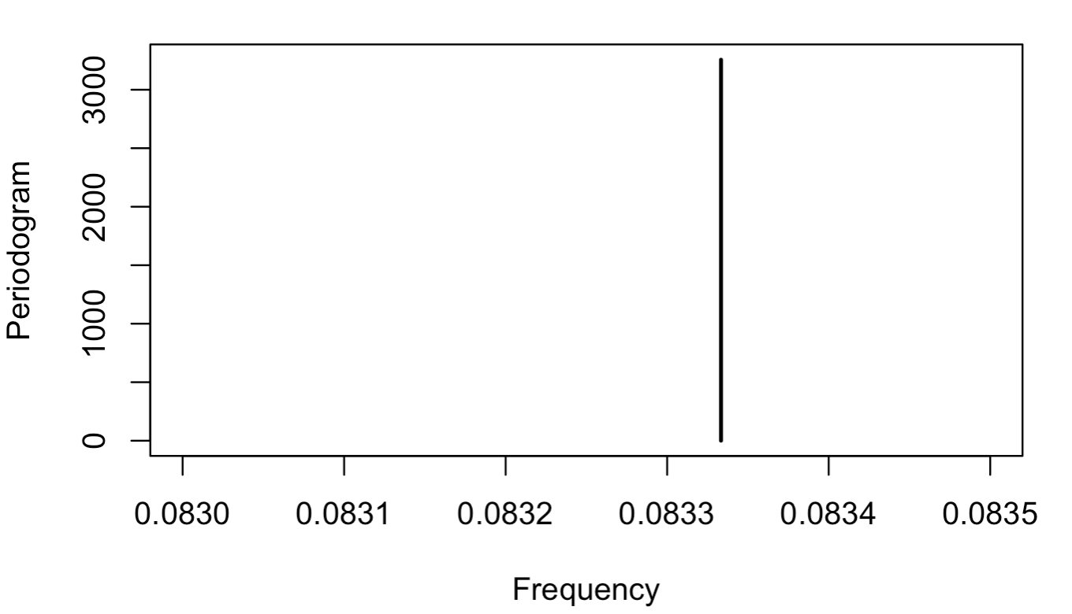
Data Overview:
ACF,PACF + Spectral Analysis
Introduction | Data | Results & Analysis | Model Selection | Conclusion
Notes:
From these two plots above, we can see that the data has a slightly positive trend and a 12-month seasonality. We can also verify this by the spectral analysis, specifically, using the periodogram to identify the dominant periods (or frequencies). Here, f = 0.083, which corresponds to a period of 1/0.083 = 12 month.
https://core.ac.uk/download/pdf/55711665.pdf
https://www.kaggle.com/sohelranaccselab/global-climate-change?select=GlobalTemperatures.csv

Slide 9
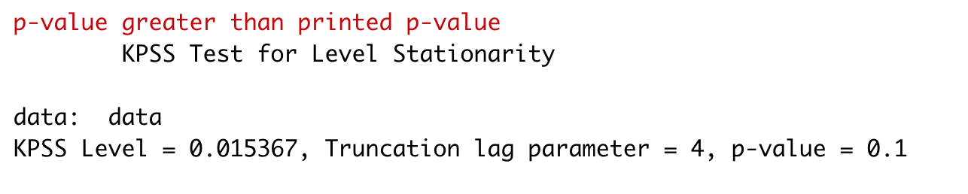
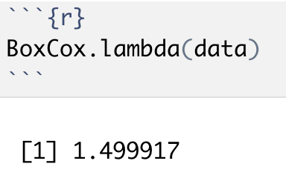
Data Overview: Hypothesis Test
Stationary?
Stabilized?
Introduction | Data | Results & Analysis | Model Selection | Conclusion
Notes:
According to the KPSS result, the p-value of the data is 0.1, greater than 0.05. Thus, we cannot reject the null hypothesis which means that our data can be concluded as stationary.
Also the boxcox transformation is necessary for our dataset. The curve is a little bit concave down when displaying the lambda, which shows changing variation as the level of the series increases. Thus, we need the Box-Cox transformation to stabilize the variance.

Slide 10
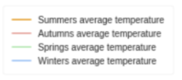
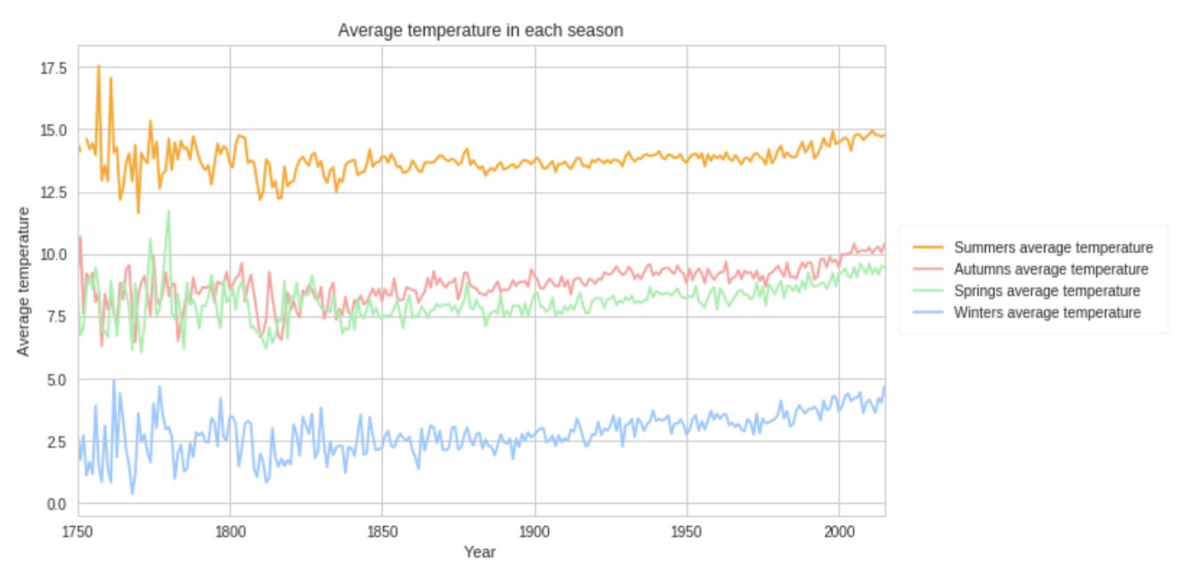
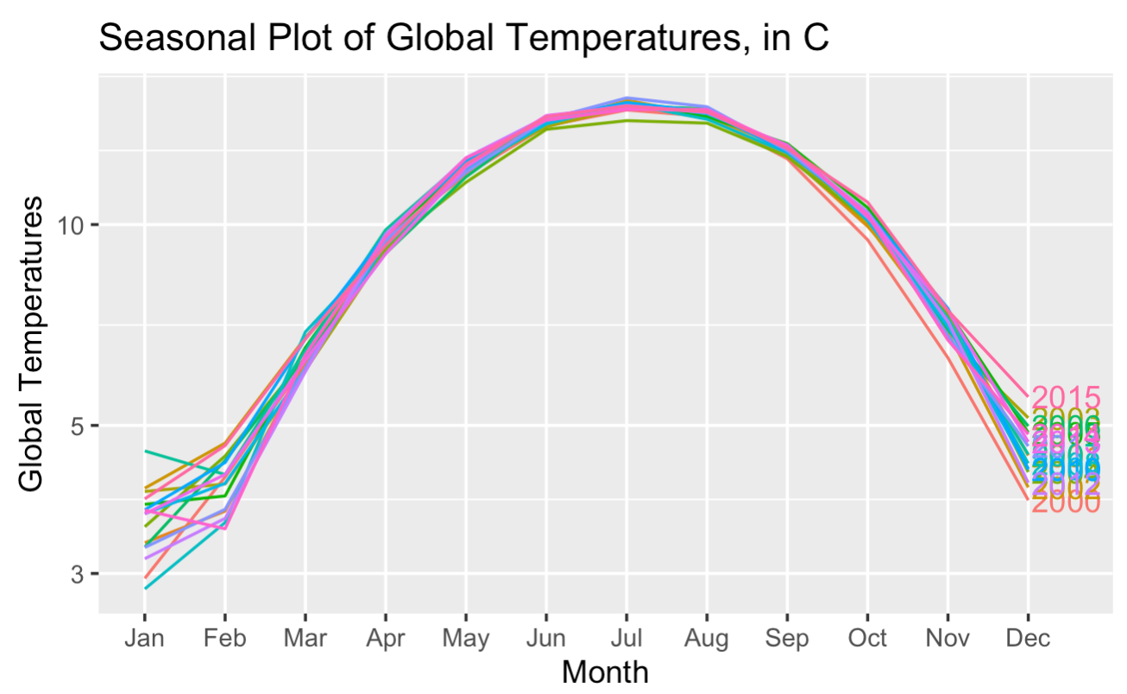

Data Overview: Monthly Global Temperature Flow
Introduction | Data | Results & Analysis | Model Selection | Conclusion
Notes:
From these two charts, we also separated the temp by different seasons. There is a clear increasing trend as time goes by, the average temperature increases.
https://www.kaggle.com/dmitriy19/some-visualizations-for-climate-change

Slide 11

Predictive Analysis
Introduction | Data | Results & Analysis | Model Selection | Conclusion
Notes:
Teresa

Slide 12
Models Explored
1
2
3
4
Linear Regression
Time Series Linear Model
Exponential Smoothing
Seasonal ARIMA
Introduction | Data | Results & Analysis | Model Selection | Conclusion
Notes:
We used four models for this data. For sarima we tried different orders to find the best arima model.

Slide 13
Validation Methods Explained
1900/1 ... 2015/12
Split Validation
Train
Test
2000/1 2012/12
Expanding Window
Backtesting
Train
Test
1912/12 1915/12
Train
Test
1913/1 1916/1
Train
Test
2012/12
Sliding
Window
Backtesting
Train
Test
1912/12 1915/12
Train
Test
1900/2 1913/1 1916/1
Train
Test
2000/1 2012/12
Introduction | Data | Results & Analysis | Model Selection | Conclusion
Notes:
Before we jump into the models, I’d like to first explain the validation methods we used. For each of the four models, we tried three different ways of validate: split, expanding window, and sliding window. To keep it consistent across methods, we kept the test time frames to be 3 years. For training, we used 12 years for sliding and split. For expanding window, we also start from 12 years.

Slide 14
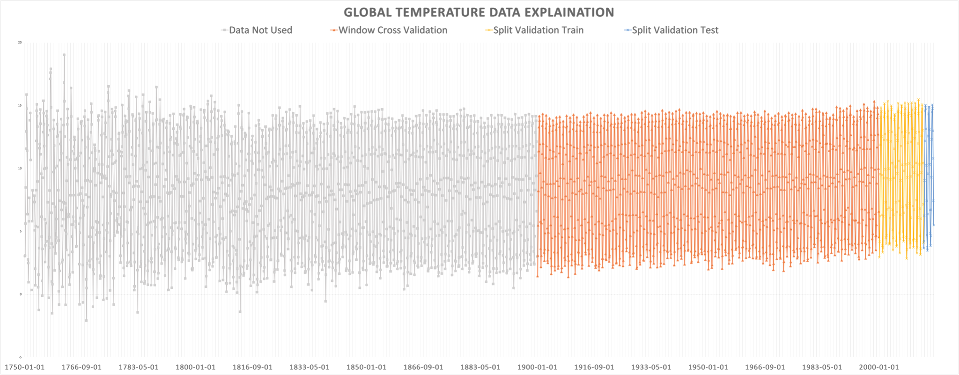
Data Explained
Introduction | Data | Results & Analysis | Model Selection | Conclusion
Notes:
Here is a graph to visualize how we utilize all the data. We discarded the grey area data from 1750 - 1900 since it’s too early to be relevant. For cross validations, we used orange to blue, and for split validation we used only yellow to blue.

Slide 15


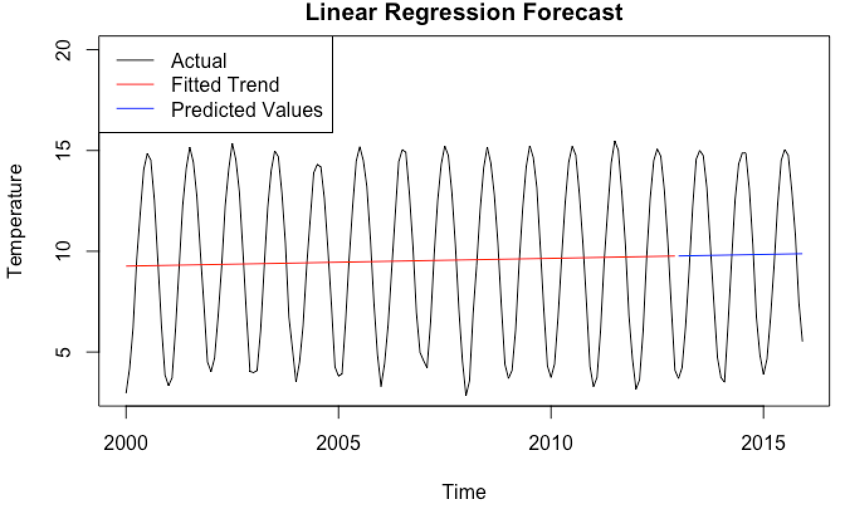
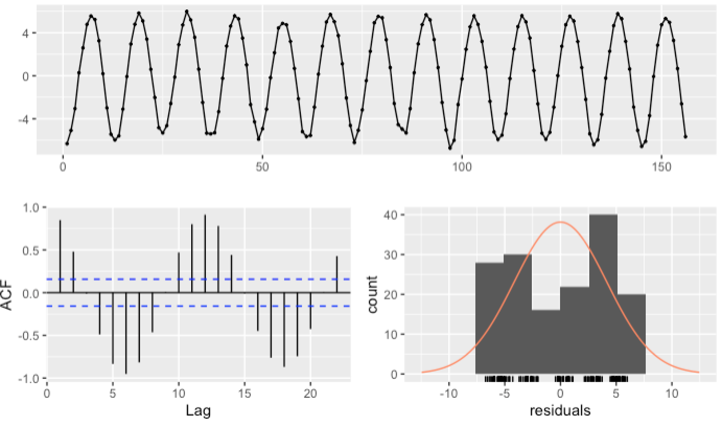
LR: Split Validation
LR | MAE | RMSE
Split | 3.68 | 4.09
LR (Splitt)
Because Linear Regression ignores seasonality, the prediction doesn’t take into account seasonality and we got residuals that are seasonal as well.
Introduction | Data | Results & Analysis | Model Selection | Conclusion
Notes:
Now let’s talk about the models we used. Note that for each model discussed we will record the MAE and RMSE score of that model on the top right corner. We also included the model that gives the least scores till this point of this presentation.
Let’s start with the first model: linear regression. We used LR as our ‘control’ model because it is the most basic. Apparently there are a lot problems. We see that with linear regression, seasonality is ignored and the predicted values is just a fitted line. As a result of that, the residuals have seasonality.

Slide 16
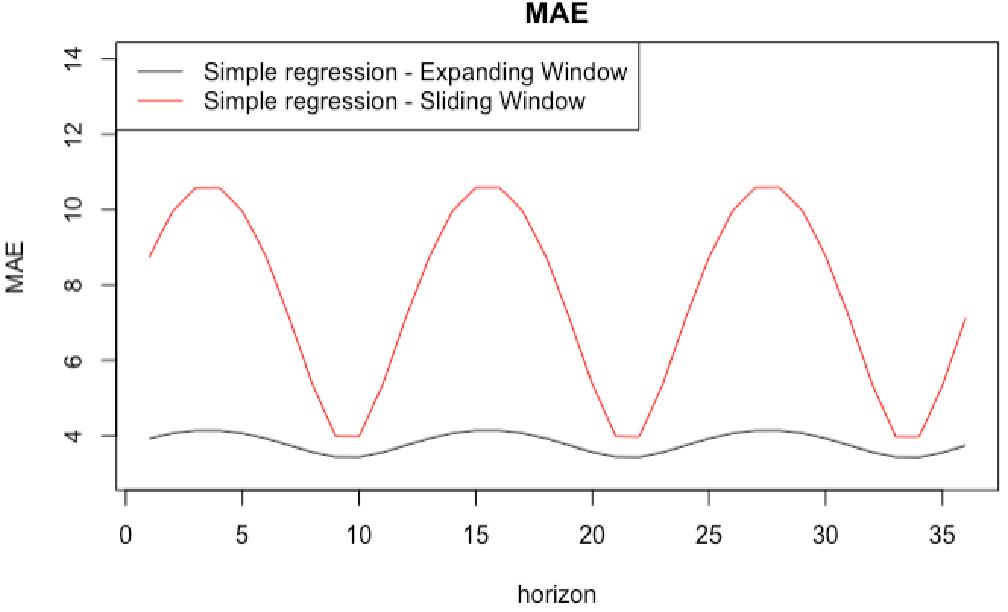
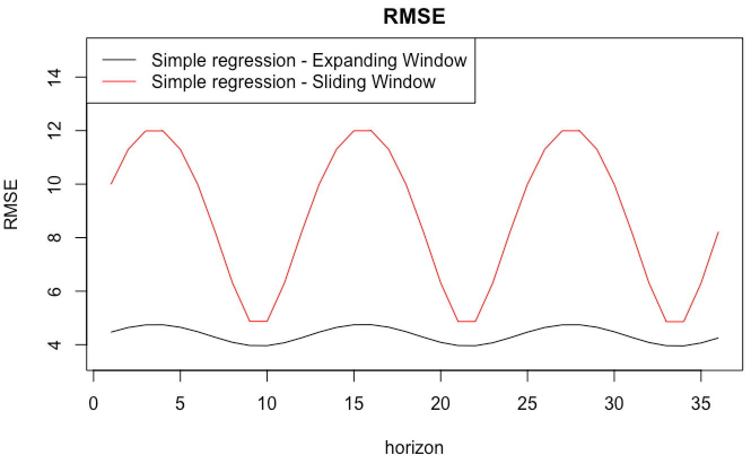
LR: Backtesting
LR | MAE | RMSE
Expanding | 6.22 | 4.10
LR (Split)
Both sliding and expanding windows are not ideal. The MAE and RMSE scores show strong seasonality and give higher values across forecasting horizons.
Introduction | Data | Results & Analysis | Model Selection | Conclusion
Notes:
For cross validation, we got even higher mae and rmse scores than those of split validation. We believe the seasonality of these scores generated when we include more winter or summer temperature in the training set, and decrease while we add more autumn and spring time to the expanding window.

Slide 17
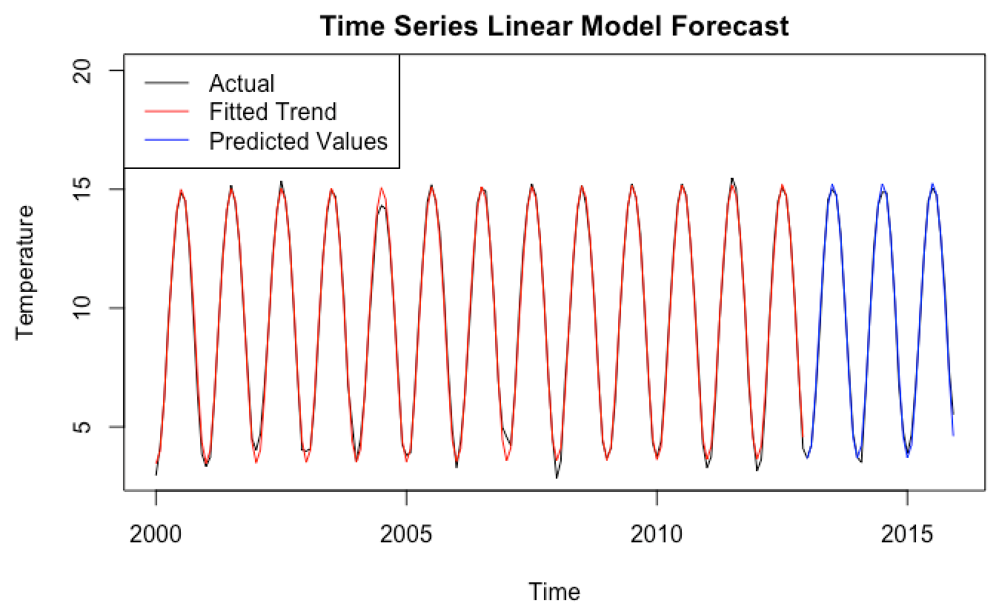
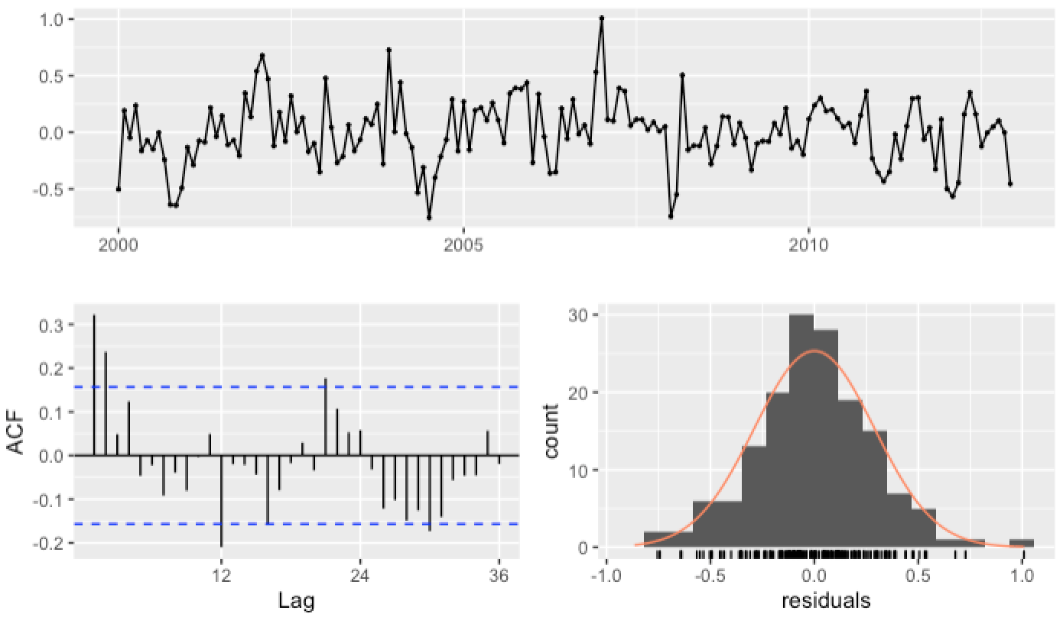
TSLM: Split Validation
TSLM | MAE | RMSE
Split | 0.21 | 0.29
TSLM (Split)
We then tried TSLM to incorporate the seasonality. The prediction result is much more accurate and the residuals follow the pattern of a white noise with most ACF values staying within the boundaries.
Introduction | Data | Results & Analysis | Model Selection | Conclusion
Notes:
Linear regression is problematic so we looked into time series linear model as an improvement. For predictors we used trend and season which are automatically generated by the tslm function in R. The prediction and fitted trend as shown in blue and red are now seasonal and close to the actual pattern. The MAE and RMSE scores are far lower comparing to linear regression.

Slide 18
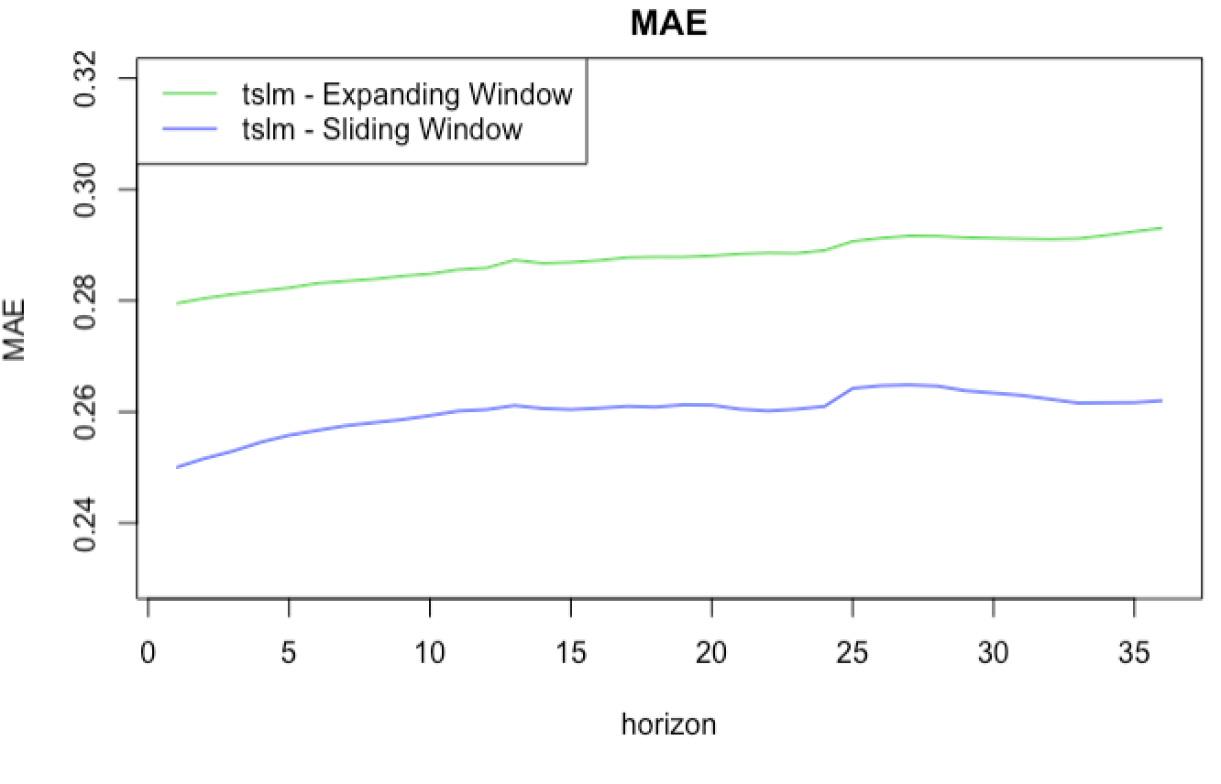
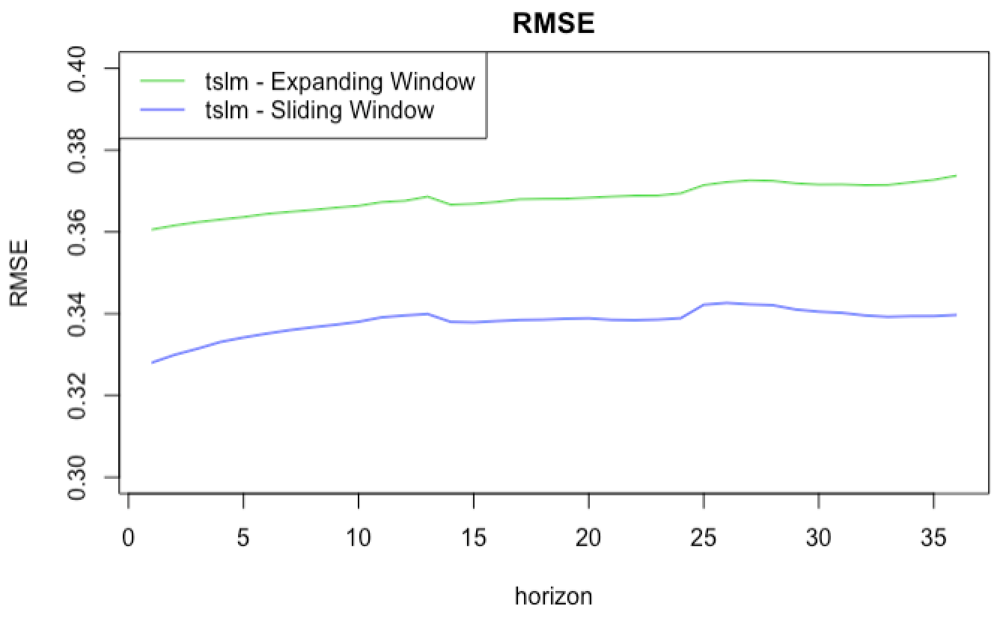
TSLM: Backtesting
TSLM | MAE | RMSE
Sliding | 0.21 | 0.29
TSLM (Split)
For cross validation, sliding windows give a better performance. The errors does not have seasonality across different horizons.
Introduction | Data | Results & Analysis | Model Selection | Conclusion
Notes:
We then applied sliding and expanding window backtesting. The MAE and RMSE scores do not have seasonality like they did in linear regression. Up till this point, TSLM performs the best. Now ruobing will introduce our work with exponential smoothing method.

Slide 19
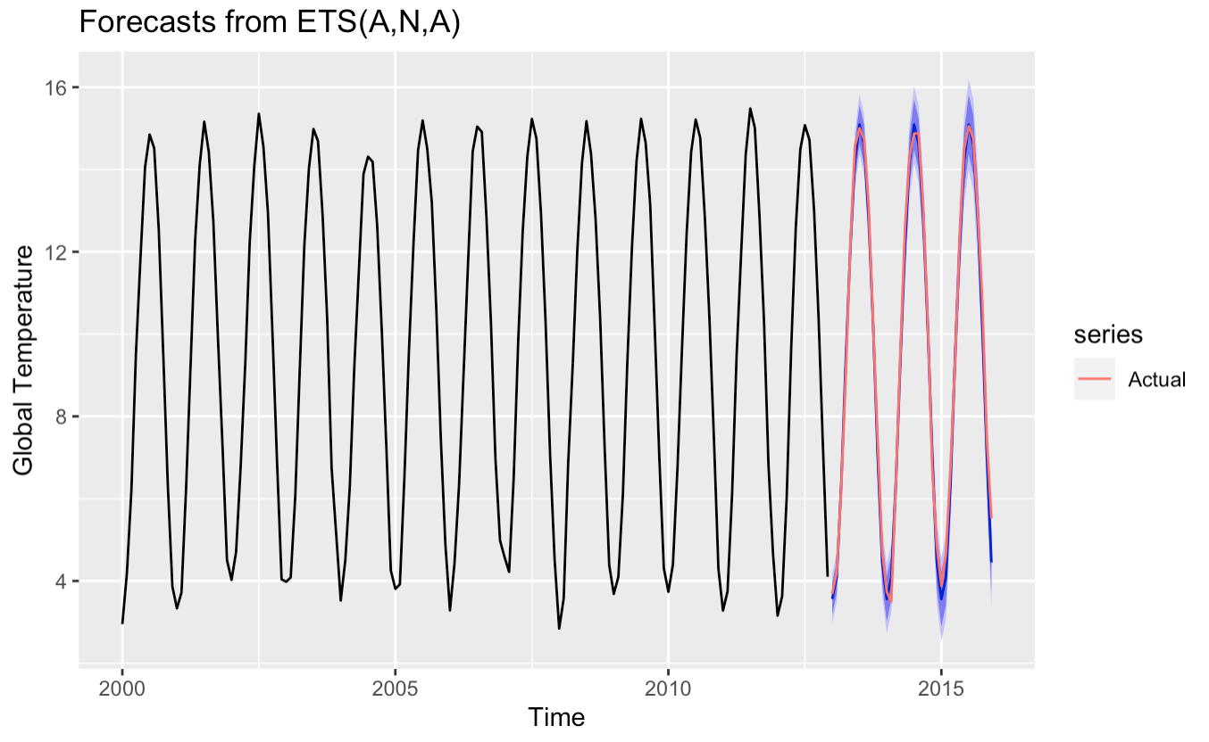
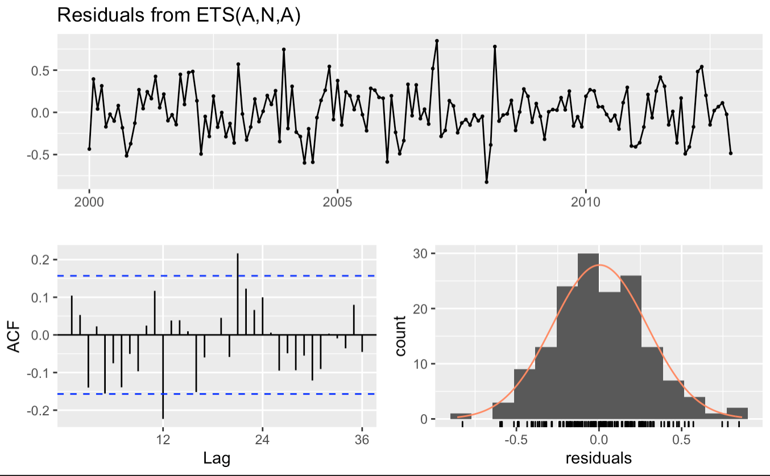
ETS Model: Split Validation
ETS | MAE | RMSE
Split | 0.27 | 0.34
TSLM (Split)
ETS function gives an ANA model, indicating an additive error model with seasonality. The residuals are not significantly different from white noise.
Introduction | Data | Results & Analysis | Model Selection | Conclusion
Notes:
We experimented with Exponential Smoothing model to do the split validation. The ets function in R gives an ANA model, indicating an additive error model with seasonality. From the left plot, we could see that the predicted values are very close to actual values and it captures the data seasonality very well. Then we checked the residuals, from the right graphs we could see that the residuals are not significantly different from white noise. The MAE and RMSE of this Exponential Smoothing model is 0.27 and 0.34 respectively, which are both higher than that of TSLM.

Slide 20
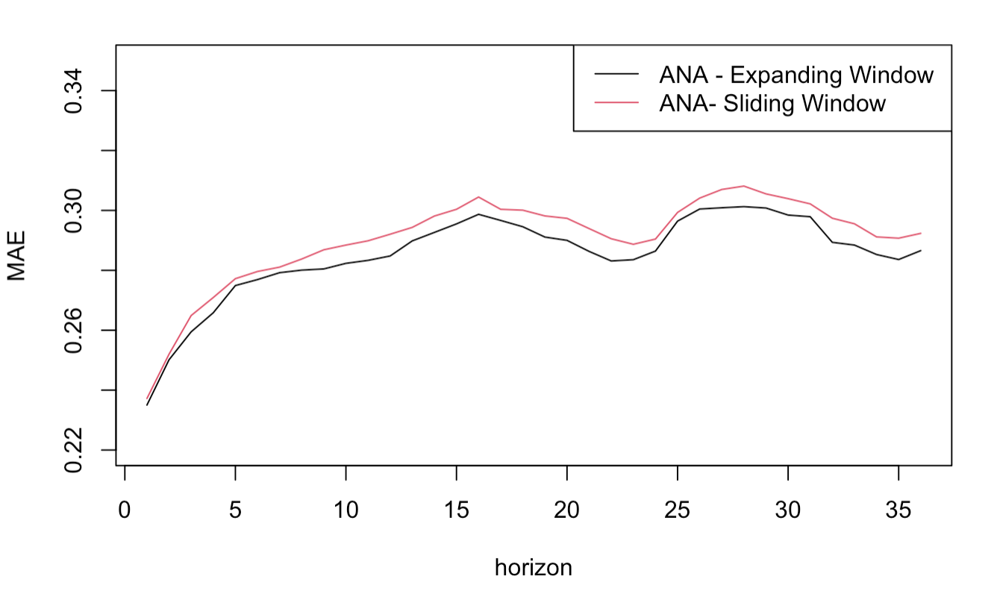
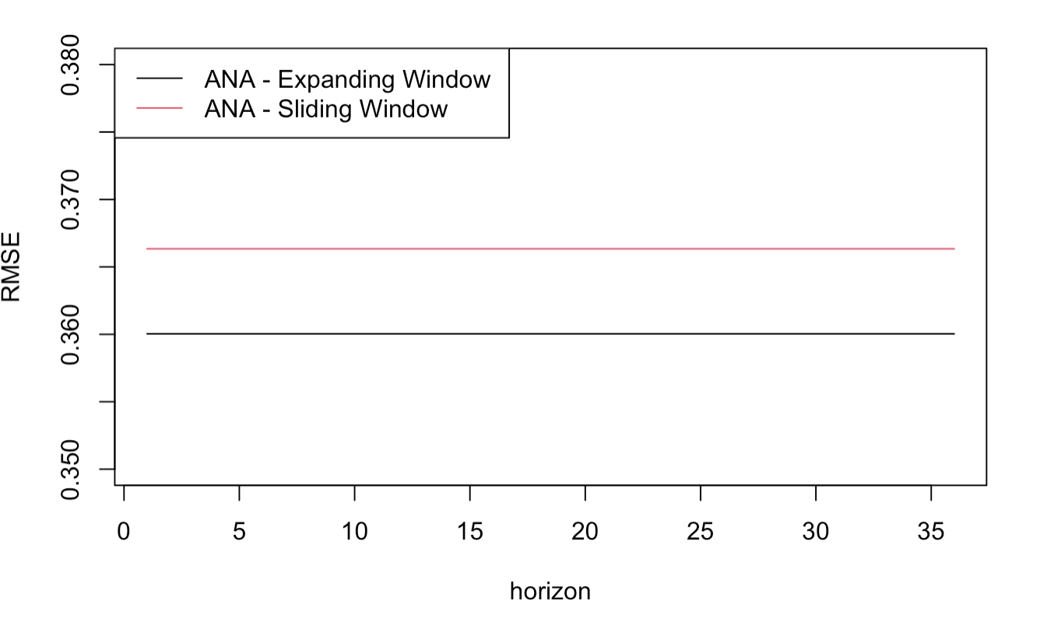
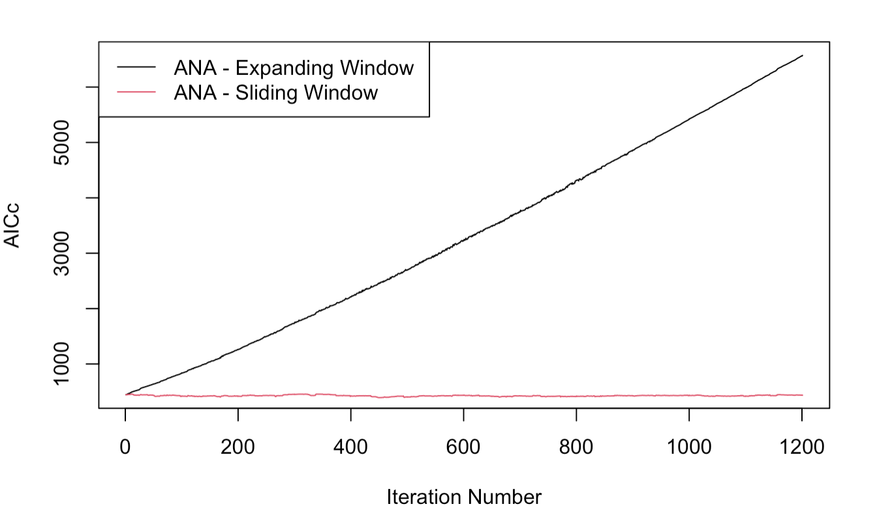
ETS Model: Backtesting
ETS | MAE | RMSE
Sliding | 0.23 | 0.29
TSLM (Split)
Expanding Window has lower MAE and RMSE scores.
AICc of Sliding Window is much lower and stable than that of Expanding Window.
Introduction | Data | Results & Analysis | Model Selection | Conclusion
Notes:
Then we run this Exponential Smoothing model with sliding and expanding window methods. Though expanding window has lower MAE and RMSE scores, these scores of two methods are very similar. Compared with expanding window, sliding window has much lower and stable AICc values across all the iterations. Thus, sliding window performs better. The MAE and RMSE scores of sliding window are on the top right corner and are still higher than that of TSLM.

Slide 21
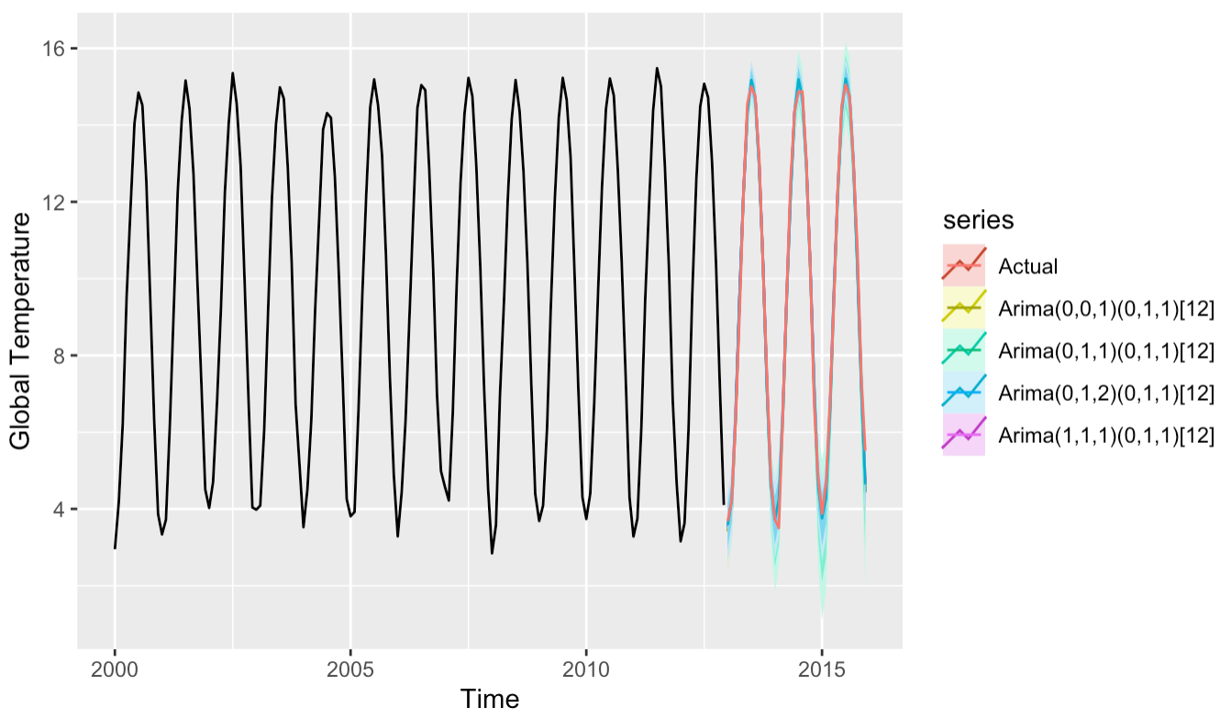
SARIMA Model: Split Validation
The auto.arima() gives the seasonal order of (0,1,1)[12]. Based on the seasonal result and eacf graph, we predict with 3 different SARIMA models. Residuals of Arima(1,1,1)(0,1,1)[12] model perform best as white noise.
Introduction | Data | Results & Analysis | Model Selection | Conclusion
Notes:
Next we experimented with SARIMA model. First, we ran auto.arima function and got the seasonal order of (0,1,1) . Then based on the eacf graph, we selected three arima order combinations as shown in the plot. We ran these four models to do the split validation. From the plot we could see that the predicted values from SARIMA(1,1,1)(0,1,1) model are closest to actual values.

Slide 22
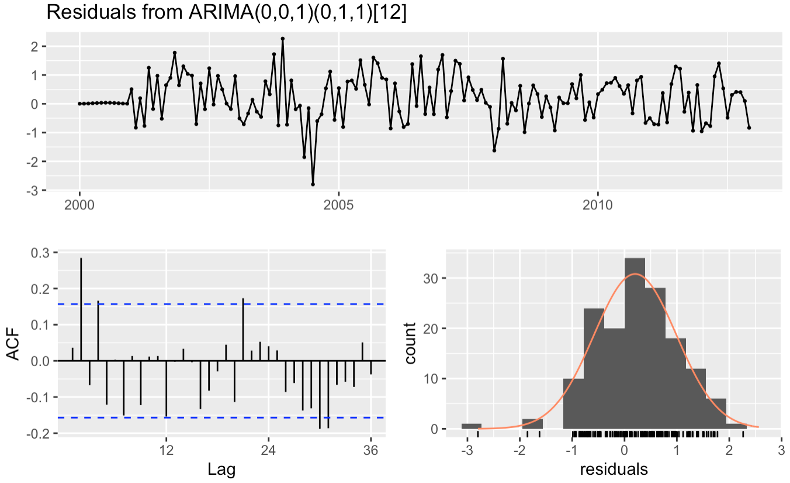
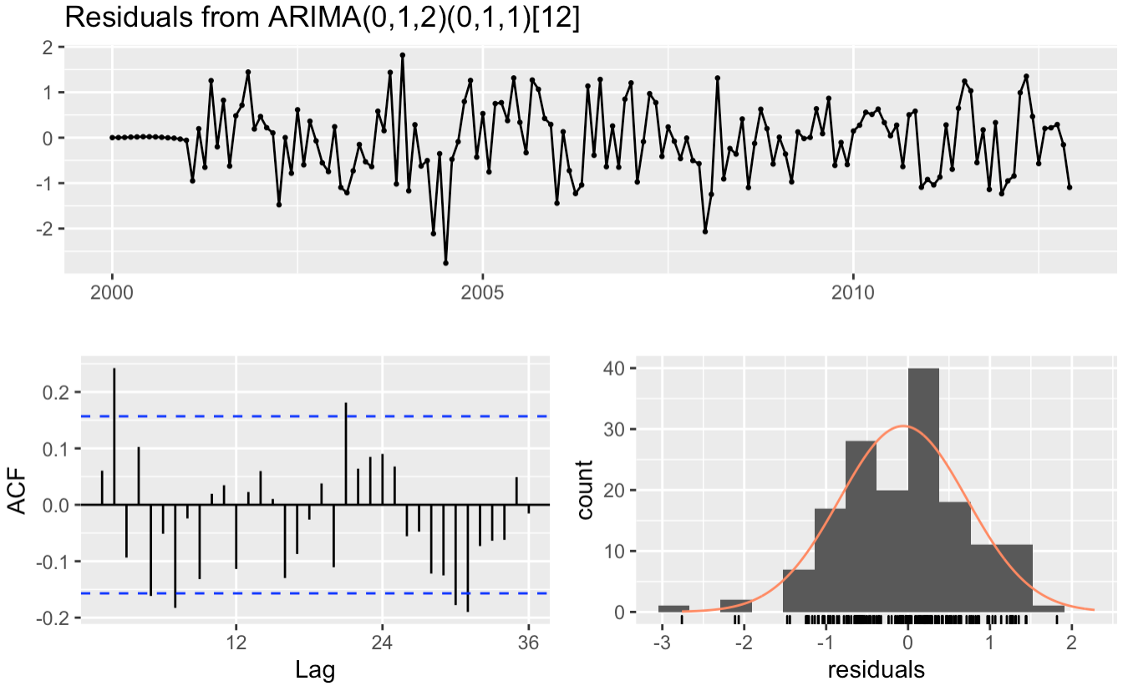
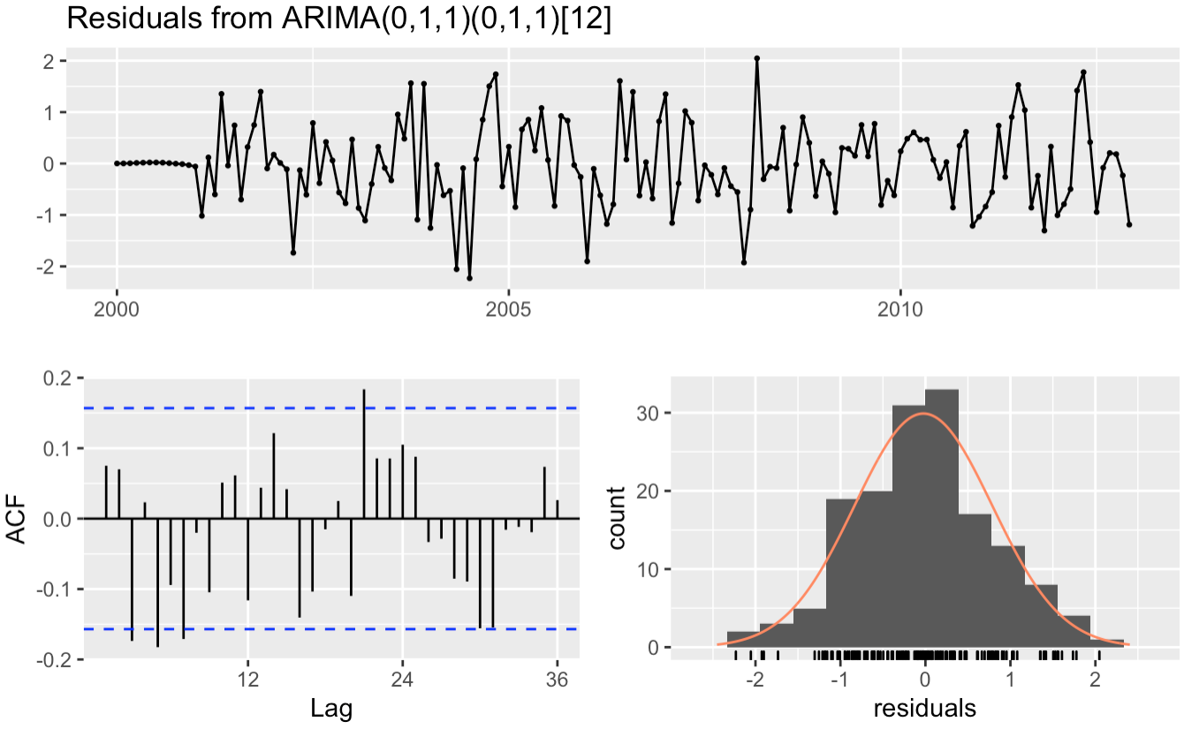
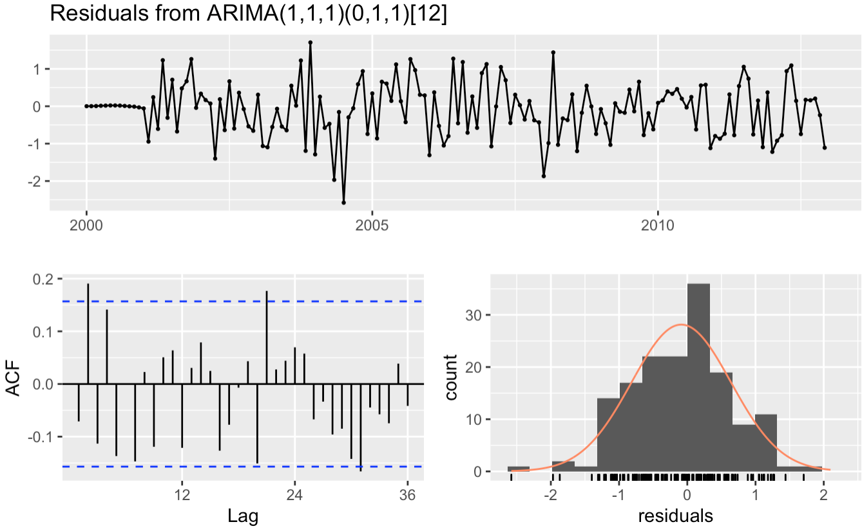
SARIMA Model: Split Validation
ARIMA(1,1,1)(0,1,1)[12] | MAE | RMSE
Split | 0.20 | 0.28
SARIMA
(Split)
Introduction | Data | Results & Analysis | Model Selection | Conclusion
Notes:
Then we check residuals of these four models. All these graphs are not significantly different from white noise. But the SARIMA(1,1,1)(0,1,1) model performs best, it only has one spike in the ACF plot. We then calculated the MAE and RMSE from this model and got 0.2 and 0.28 respectively. Up till now, this SARIMA(1,1,1)(0,1,1) performs best.

Slide 23
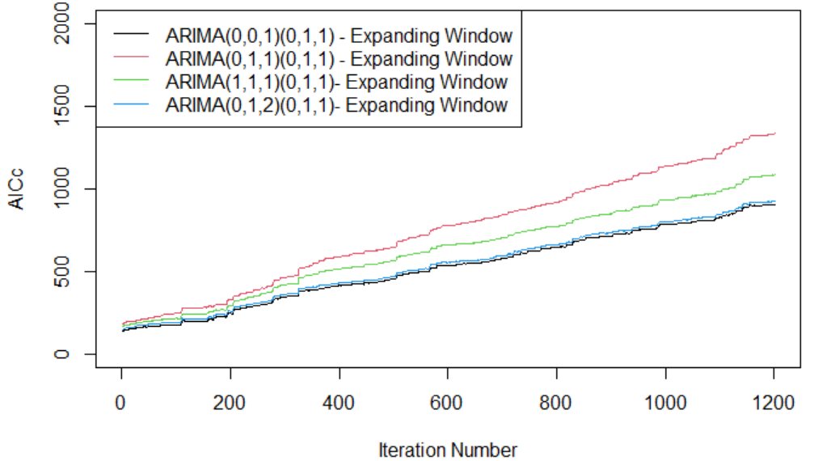
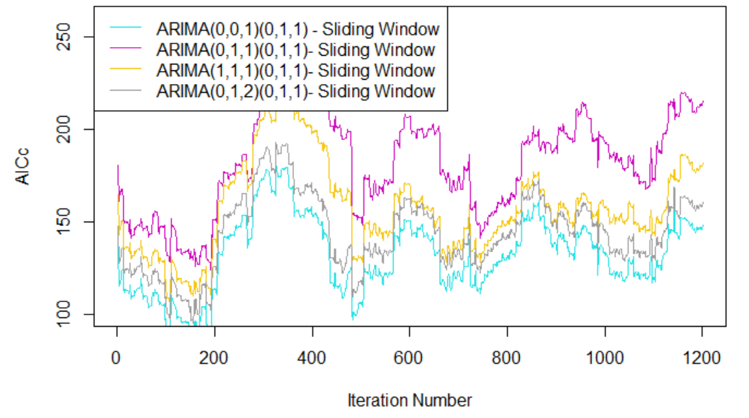
SARIMA Model: Backtesting
SARIMA (0,0,1)(0,1,1) | MAE | RMSE
Sliding | 0.4 | 0.5
SARIMA(Split)
Auto.arima() gives the order of (0,0,1)(0,1,1). Fit another 3 models based on the seasonal order and eacf
Models with sliding window have lower AICc than those with expanding window
SARIMA model (0,0,1)(0,1,1) with sliding window performed the best
AICc: Expanding Window
AICc: Sliding Window
Introduction | Data | Results & Analysis | Model Selection | Conclusion
Notes:
Thank you ruobing, so for SARIMA models with cross validation, We tested 4 combinations of orders with both sliding and expanding window, and that makes us 8 models in total. Just like previously, the selection of orders comes from the order given by the auto.arima and eacf function. In other words, the order of (0,0,1)(0,1,1) was determined by the auto.arima function, and then we kept the orders of the seasonal part constant, while trying different orders for the non-seasonal part, based on the result from the eacf function. Next we plotted the AICc scores against iteration numbers for all of the models. I divided the graph into two parts, one is for the models with expanding window and the other is for the ones with sliding window, since the range of AICc for models with expanding window are closer to each other and it’s the same situation for models with sliding window.
By looking at the AICc scores, we can tell that in general, models with sliding window perform better. And on the right of the slide, among all models with sliding window, we can see the blue line -- which is the model with order (0,0,1)(0,1,1) generally is lower than the rest of the models, thus we determined that this model is the best out of the 8 models, its MAE is 0.4, and RMSE is 0.5, which are still higher than those of the sarima model(1,1,1)(0,1,1) with split validation from the previous slide

Slide 24

Model Evaluation &
Model Selection
Introduction | Data | Results & Analysis | Model Selection | Conclusion
Notes:
So that covers all models we have, Next let’s summarize our models

Slide 25
MAE & RMSE: Determine the best model
Model | MAE | RMSE
Linear Regression Model | 3.68 | 4.09
Time Series Linear Model | 0.21 | 0.29
ETS (“ANA”) Model | 0.23 | 0.29
SARIMA (1,1,1)(0,1,1)[12] | 0.20 | 0.28
Introduction | Data | Results & Analysis | Model Selection | Conclusion
Notes:
Recall that we tried four types of models, including linear regression, time series linear model, exponential smoothing, and sarima, with different methods of validation. And at each step, we have compared our newest model with the best model we’ve tried previously. On the slide we have the best models for each type with their accuracy scores, and by comparing them all together, we found that the SARIMA model (1,1,1)(0,1,1) gives us the best results. We selected this one as our final model to forecast future temperature.

Slide 26
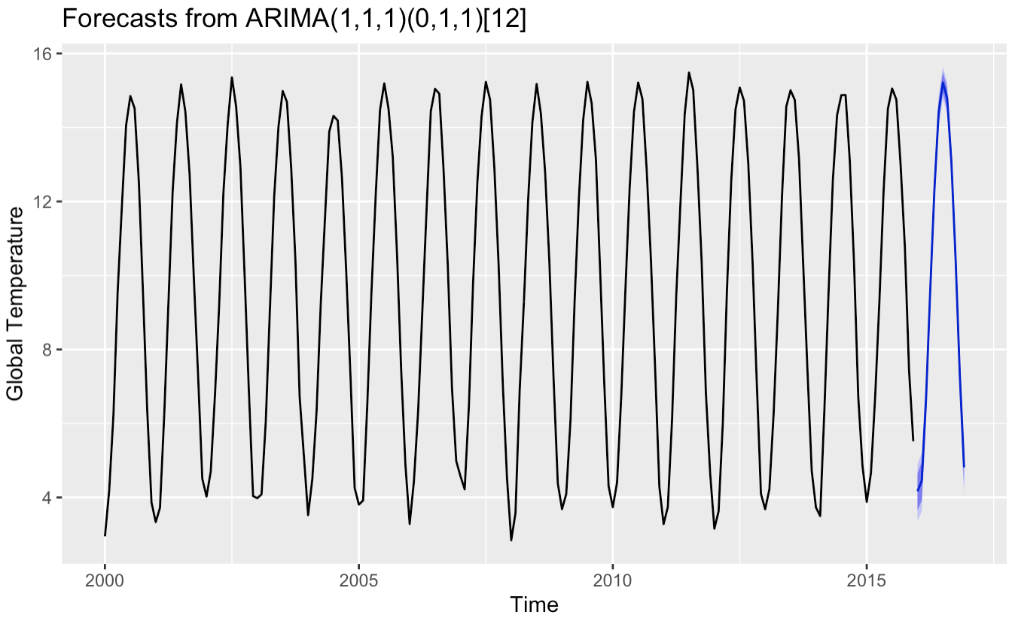
One-Year Prediction: 2016 Global Temperature
2016 | Temperature Prediction (°C)
Jan | 4.169
Feb | 4.451
Mar | 6.618
Apr | 9.576
May | 12.338
Jun | 14.421
Jul | 15.212
Aug | 14.795
Sep | 13.075
Oct | 10.441
Nov | 7.281
Dec | 4.815
Introduction | Data | Results & Analysis | Model Selection | Conclusion
Notes:
And on the next slide we have the forecasting temperatures for the next 12 months using our best model
And next Teresa will go through our conclusion and future work

Slide 27

Conclusion & Future Work
Introduction | Data | Results & Analysis | Model Selection | Conclusion

Slide 28
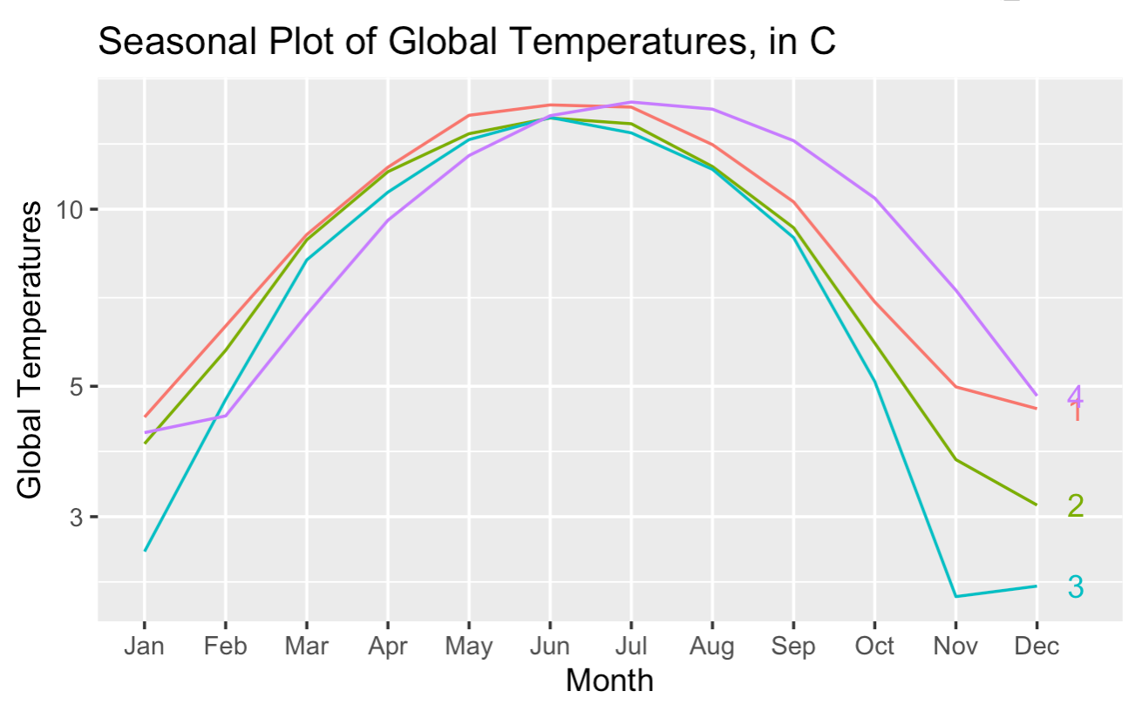
Takeaways
29
Raise 1.38°C/2.48°F between 1753 (the earliest record) and 2016
Raise 0.32°C/0.57°F between 2015 and 2016
2016
2006
1886
1786
Introduction | Data | Results & Analysis | Model Selection | Conclusion
Notes:
According to our prediction, in year 2016, the global temperature would have raised 1.38°C between 1753 (the earliest record) and 2016.
In addition, the one-year temperature raise from 2015 to 2016 is estimated to be 0.32°C. Looking back at hindsight, 5 warmest years on record happened since 2015 according to Natural Resources Defense Council’s article in 2021.. If such time series prediction raised attention on the warming trend, we could have taken better actions in climate protection.

Slide 29

Future Works
Conclusion
Find daily data to allow for daily prediction
Introduce other variables such as sun insolation, greenhouse gases, etc.
Use hold out data to examine overfitting
Examine whether temperature forecast can be leveraged in other applications such as extreme weather and crop yield
Out of the models we trained (simple linear regression, time series linear model, exponential smoothing, and different seasonal arima models), SARIMA(1,1,1)(0,1,1)[12] with split validation gives the lowest MAE and RMSE score.
Introduction | Data | Results & Analysis | Model Selection | Conclusion
Notes:
There are several ways we can improve our analysis. In the future we can find daily data to conduct daily prediction, introduce other variables, use data after 2015 as hold out, and find more applications in extreme weather prediction, crop yield, etc.
To summarize, in this project we used global temperature from previous year to forecast 2016 global temperature. The best model we created was SARIMA with order 110 and seasonal order 011 which gives the lowest MAE and RMSE scores.

Slide 30
Thank You!
Notes:
That concludes our presentation. Thank you and now we will open the floor for questions.

